Slide 1
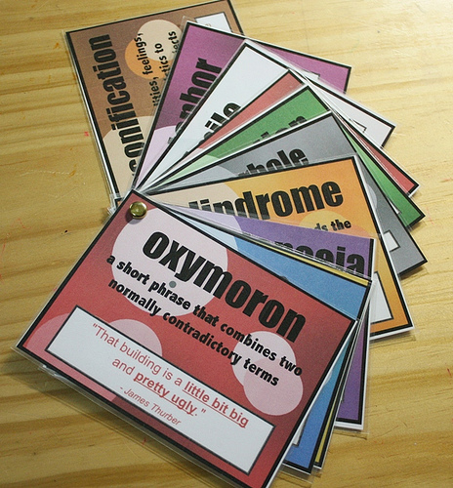
Literary Devices:
Interesting when you read, useful when you write!

Slide 2
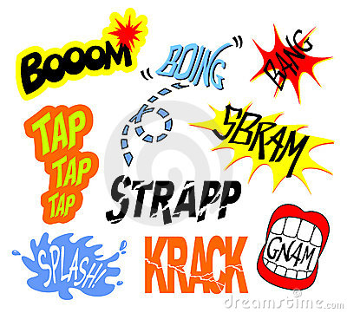
ONOMATOPOEIA
is a word that imitates the sound it represents.
Examples:
crunch
zap
tick-tock
whoosh

Slide 3
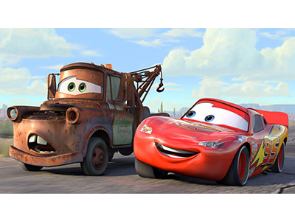
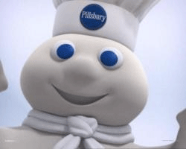
PERSONIFICATION
is when a writer gives human qualities to animals or objects.
Examples:
My car drank the gasoline in one gulp.
The cat laughed.
The newspaper headline glared at me.

Slide 4
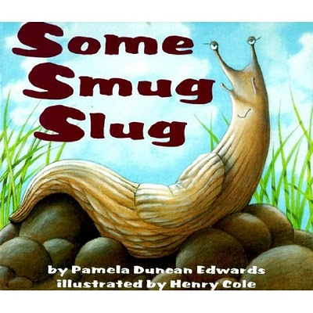
ALLITERATION
is the repetition of the same consonant sound in words occurring near one another.
Examples:
Peter Piper picked a peck of pickled peppers.
Sally sells seashells by the seashore.

Slide 5
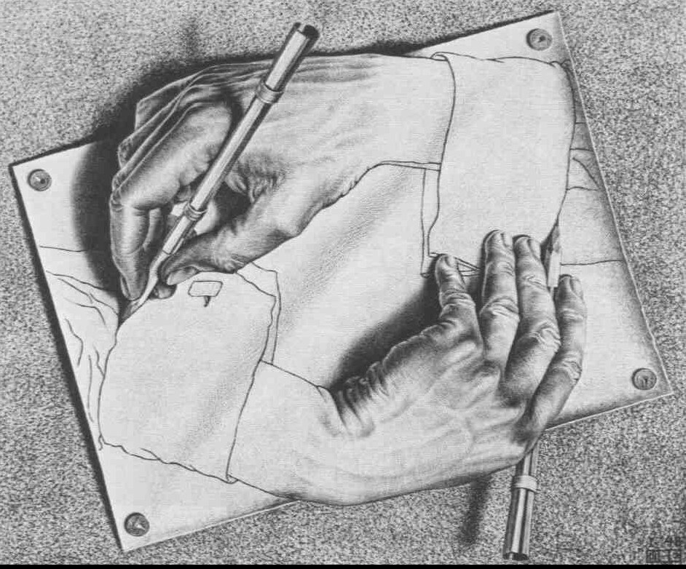
PARADOX
a statement that contradicts itself and still seems true somehow.
Examples:
-He was a brave coward.
-When you win all the time, you lose.
-Nobody goes to the restaurant because it's too crowded.

Slide 6
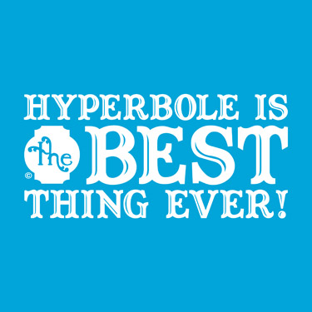
HYPERBOLE
is an obvious exaggeration or overstatement.
Examples:
-I’m so hungry I could eat a horse!
-This car goes faster than the speed of light.
-Our new house cost a bazillion dollars.

Slide 7

SIMILE
is an expression comparing one thing to another using the words “like” or “as”.
Examples:
He ran like a cat, lightly and quietly.
Her bad mood passed as quickly as an afternoon rain shower.

Slide 8
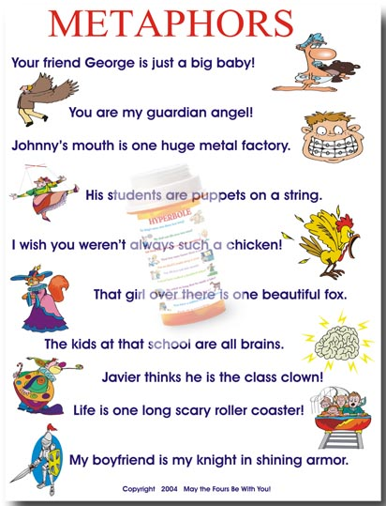
METAPHOR
is a comparison of two unlike things without using the words “like” or “as”.
Examples:
He was a statue, waiting to hear the news.
She was a mother hen, trying to take care of everyone around her.

Slide 9
POETRY CATEGORIES
Narrative Poem: A poem that tells a story. Narrative poems are usually contrasted with lyric poems.
Lyric Poem: Poetry that expresses a speaker’s personal thoughts or feelings.
Free Verse: Poetry that has no fixed pattern of meter, rhyme, line length, or stanza arrangement.

Slide 10
TWO TYPES OF RHYME
End Rhyme: The rhyming of words at the end of a line.
  Example: They could not excuse the sin.
    That was committed by his kin.
Internal Rhyme: Rhyme that occurs within a single line of poetry.
  Example: No, baby, no, you may not go.”

Slide 11
RHYME SCHEME
Rhyme Scheme: The pattern that end rhymes form in a stanza or poem.
Rhyme scheme is designated by the assignment of a different letter of the alphabet to each new rhyme.
Roses are red A
Violets are blue B
You stole my heart C
Then were untrue B

Slide 12
STANZA
In poetry, a stanza is a division of four or more lines.
  Stanzas in poetry are similar to paragraphs in prose. Both stanzas and paragraphs include connected thoughts, and are set off by a space.
“He clasps the crag with crooked hands: ←------ stanza 1
Close to the sun it lonely lands,
Ringed with the azure world, it stands.
The wrinkled sea beneath him crawls;
He watches from his mountain walls, ←------ stanza 2
And like a thunderbolt he falls.”

Slide 13
RHYTHM
In literature, rhythm is the pattern of stressed and unstressed beats. Rhythm is most commonly found in poetry. The rhythm of a poem can be analyzed through the number of lines in a verse or the number of syllables in the line.
Example: (The words in ALL CAPS are stressed. Each line has the same amount of syllables per line. Below has 10 syllables.)
“So LONG as MEN can BREATHE, or EYES can SEE,
So LONG lives THIS, and THIS gives LIFE to THEE.”

Slide 14
METER
Meter is a stressed and unstressed syllabic pattern in a verse, or within the lines of a poem.
  Stressed syllables tend to be longer, and unstressed shorter.
“The SAFest PLACE on PLANet EARTH.”
(Iambic meter)
Iambic meter pattern: Unstressed syllable, stressed syllable, unstressed syllable, stressed syllable, etc.

